Slide 1
Notes:
Project Management 6e.
3-<number>

Slide 2
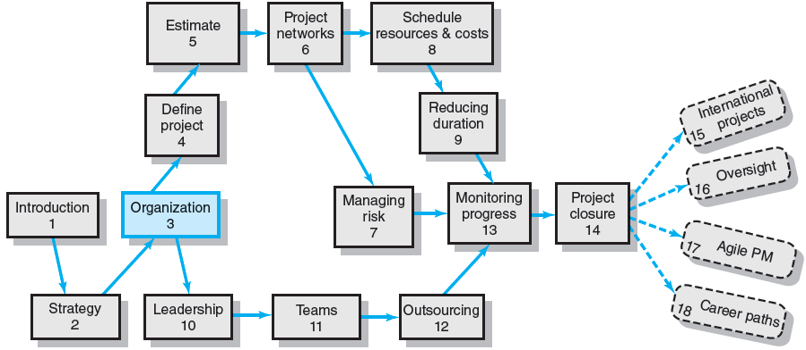
Where We Are Now
3–<number>
Notes:
Project Management 6e.
3-<number>

Slide 3


Project Management Structures
Challenges to Organizing Projects
  The uniqueness and short duration of projects relative to ongoing longer-term organizational activities
  The multidisciplinary and cross-functional nature of projects creates authority and responsibility dilemmas.
Choosing an Appropriate Project Management Structure
  The best system balances
  the needs of the project
  with the needs of the
  organization.
3–<number>
Notes:
Project Management 6e.
3-<number>

Slide 4
Project Management Structures (cont’d)
Organizing Projects: Functional organization
  Different segments of the project are delegated
  to respective functional units.
  Coordination is maintained through normal management channels.
  Used when
    the interest (work content) of one functional area dominates the project or
    one functional area has a dominant interest in the project’s success.
3–<number>
Notes:
Project Management 6e.
3-<number>

Slide 5
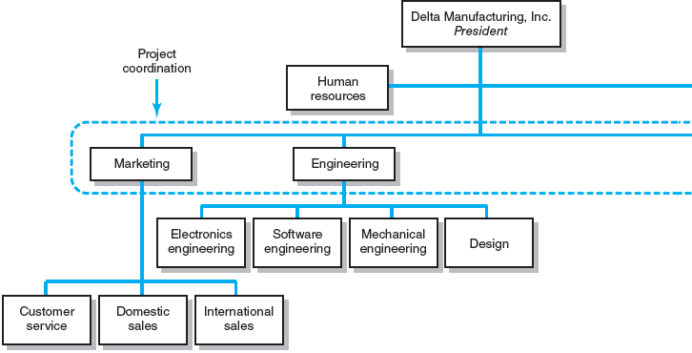
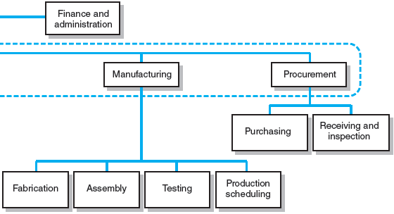
Functional Organizations
FIGURE 3.1
3–<number>
Notes:
Project Management 6e.
3-<number>

Slide 6
Functional Organization of Projects
Advantages
  No structural change
  Flexibility
  In-depth expertise
  Easy post-project transition
Disadvantages
  Lack of focus
  Poor integration
  Slow
  Lack of ownership
3–<number>
Notes:
Project Management 6e.
3-<number>

Slide 7
Project Management Structures (cont’d)
Organizing Projects: Dedicated Teams
  Teams operate as separate units under the leadership of a full-time project manager.
  In a projectized organization where projects are the dominant form of business, functional departments are responsible for providing support for its teams.
3–<number>
Notes:
Project Management 6e.
3-<number>

Slide 8
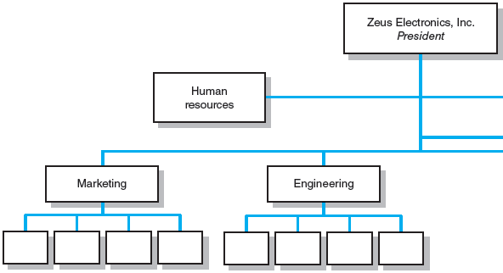
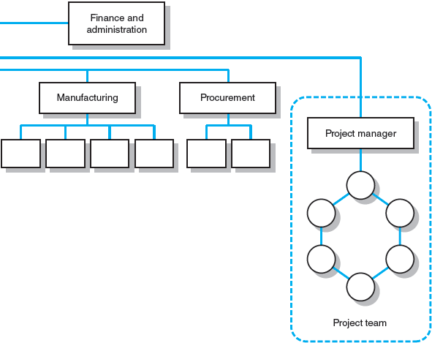
Dedicated Project Team
FIGURE 3.2
3–<number>
Notes:
Project Management 6e.
3-<number>

Slide 9
Project Organization: Dedicated Team
Advantages
  Simple
  Fast
  Cohesive
  Cross-Functional Integration
Disadvantages
  Expensive
  Internal Strife
    Divisiveness between project team and the parent company
  Limited (in house) Technological Expertise
  Difficult Post-Project Transition
3–<number>
Notes:
Project Management 6e.
3-<number>

Slide 10
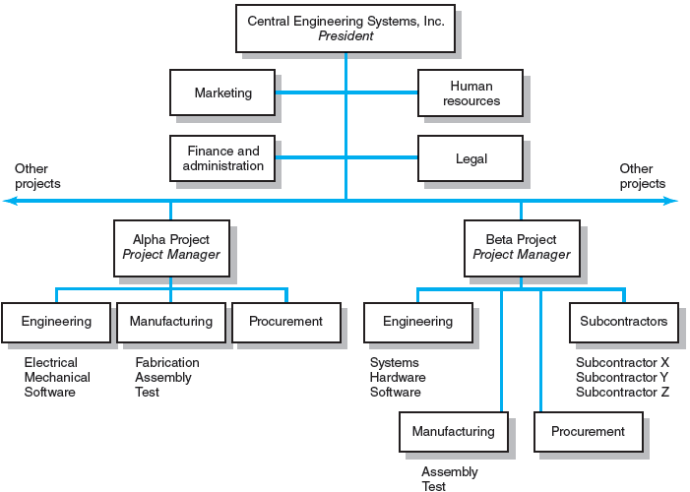
Projectized Organizational Structure
FIGURE 3.3
3–<number>
Notes:
Project Management 6e.
3-<number>

Slide 11
Project Management Structures (cont’d)
Organizing Projects: Matrix Structure
  Hybrid organizational structure (matrix) is overlaid on the normal functional structure.
    Two chains of command (functional and project)
    Project participants report simultaneously to both functional and project managers.
  Matrix structure optimizes the use of resources.
    Allows for participation on multiple projects while performing normal functional duties.
    Achieves a greater integration of expertise and project requirements.
3–<number>
Notes:
Project Management 6e.
3-<number>

Slide 12
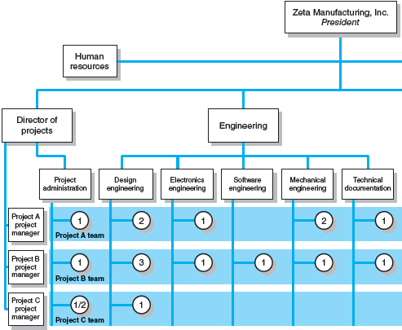
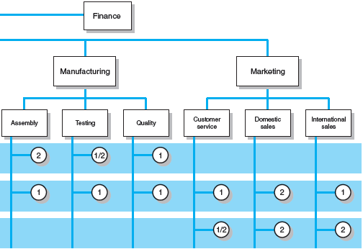
Matrix Organization Structure
FIGURE 3.4
3–<number>
Notes:
Project Management 6e.
3-<number>

Slide 13
Division of Project Manager and Functional Manager Responsibilities in a Matrix Structure
Project Manager Negotiated Issues Functional Manager
What has to be done? Who will do the task? How will it be done?
When should the task be done? Where will the task be done?
How much money is available Why will the task be done? How will the project involvement
to do the task? impact normal functional activities?
How well has the total project Is the task satisfactorily How well has the functional
been done? completed? input been integrated?
TABLE 3.1
3–<number>
Notes:
Project Management 6e.
3-<number>

Slide 14
Different Matrix Forms
Weak Form
  The authority of the functional manager predominates and the project manager has indirect authority.
Balanced Form
  The project manager sets the overall plan and the functional manager determines how work to be done.
Strong Form
  The project manager has broader control and functional departments act as subcontractors
  to the project.
3–<number>
Notes:
Project Management 6e.
3-<number>

Slide 15
Project Organization: Matrix Form
Advantages (compared to functional org.)
  Efficient
  Strong Project Focus
  Easier Post-Project Transition
  Flexible
Disadvantages
  Dysfunctional Conflict
    Predicated on tension between functional managers and project managers,
    Due to different expertise & perspectives, resulting from conflicting agendas and accountabilities.
  Infighting
    Among project managers due to sharing resources
  Stressful
    As it violates the unity of command mgt. principle
  Slower than projectized org.
    In order to forge agreements across functional groups
3–<number>

Slide 16
Choosing the Appropriate Project Management Structure
Organization (Form) Considerations
  How important is project (mgt.) to the firm’s success?
    If critical, => consider projectized organization
  What percentage of core work involves projects?
    More than 75% of core work involves projects => use project org.
    Have both MTS & MTO in the org., => consider matrix.
    Very few projects, => dedicated teams or outsourcing
  What level of critical resources (human and physical)
  are available?
    Somewhat available but need to share, => matrix
    Not available, => outsourcing
3–<number>

Slide 17
Choosing the Appropriate Project Management Structure (cont’d)
Project Considerations
  Size of project
  Strategic importance
  Novelty and need for innovation
  Need for integration (number of departments involved)
  Environmental complexity (number of external interfaces)
  Budget and time constraints
  Stability of resource requirements
Notes:
  The higher the levels of these factors, the more autonomy and authority the project manger and project team need in order to be successful
3–<number>

Slide 18
Organizational Culture
Organizational Culture Defined
  A system of shared norms, beliefs, values, and assumptions which bind people together, thereby creating shared meanings.
  The “personality” of the organization that sets it
  apart from other organizations.
    Provides a sense of identify to its members.
    Helps legitimize the management system of the organization.
    Clarifies and reinforces standards of behavior.
3–<number>
Notes:
Project Management 6e.
3-<number>

Slide 19
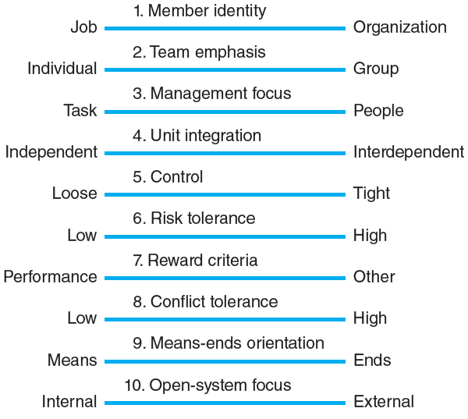
Key Dimensions Defining an Organization’s Culture
FIGURE 3.5
3–<number>
Notes:
Project Management 6e.
3-<number>

Slide 20

Identifying Cultural Characteristics
Study the physical characteristics
of an organization.
Read about the organization.
Observe how people interact
within the organization.
Interpret stories and folklore
surrounding the organization.
3–<number>
Notes:
Project Management 6e.
3-<number>

Slide 21
Organizational Culture Diagnosis Worksheet
Power Corp.
I. Physical Characteristics:
Architecture, office layout, décor, attire
Corporate HQ is 20 Story modern building—president on top floor. Offices are bigger in the top floors than lower floors. Formal business attire (white shirts, ties, power suits, . . . ) Power appears to increase the higher up you are.
II. Public Documents:
Annual reports, internal newsletters, vision statements
At the heart of the Power Corp. Way is our vision . . . to be the global energy company most admired for its people, partnership and performance. Integrity. We are honest with others and ourselves. We meet the highest ethical standards in all business dealings. We do what we say we will do.
III. Behavior:
Pace, language, meetings, issues discussed, decision-making style, communication patterns, rituals
Hierarchical decision-making, pace brisk but orderly, meetings start on time and end on time, subordinates choose their words very carefully when talking to superiors, people rarely work past 6:00 P.M., president takes top performing unit on a boat cruise each year . . .
IV. Folklore:
Stories, anecdotes, heroines, heroes, villains
Young project manager was fired after going over his boss’s head to ask for additional funds.
Stephanie C. considered a hero for taking complete responsibility for a technical error.
Jack S. was labeled a traitor for joining chief competitor after working for Power Corp. for 15 years.
FIGURE 3.6
3–<number>
Notes:
Project Management 6e.
3-<number>

Slide 22

Implications of Organizational Culture
for Organizing Projects
Challenges for Project Managers
in Navigating Organizational Cultures
  Interacting with the culture and subcultures
  of the parent organization
  Interacting with the project’s clients
  or customer organizations
  Interacting with other organizations
  connected to the project
3–<number>
Notes:
Project Management 6e.
3-<number>

Slide 23
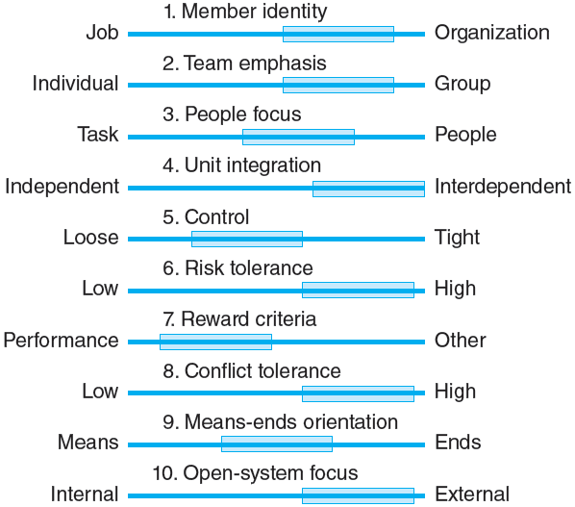
Cultural Dimensions of an Organization Supportive
of Project Management
FIGURE 3.7
3–<number>
Notes:
Project Management 6e.
3-<number>

Slide 24
Key Terms
Balanced matrix
Dedicated project team
Matrix
Organizational culture
Projectized organization
Project Office (PO)
Strong matrix
Weak matrix
3–<number>
Notes:
Project Management 6e.
3-<number>

